Slide 1
SVR REGRESSION

Slide 2
NOTE
SVR does not include the feature scaling as some of the linear regression models from sklearn
So do perform feature scaling separately
For SVR use regression template

Slide 3
Python

Slide 4
Import libraries
import pandas as pd
import numpy as np
import matplotlib.pyplot as plt

Slide 5
Read Dataset
dataset = pd.read_csv("D:\machine learning AZ\Machine Learning A-Z Template Folder\Part 2 - Regression\Section 7 - Support Vector Regression (SVR)\SVR\Position_Salaries.csv")
X = dataset.iloc[:,1:2].values
y = dataset.iloc[:,2:3].values

Slide 6
Feature scaling
from sklearn.preprocessing import StandardScaler
sc_X = StandardScaler()
sc_y = StandardScaler()
X = sc_X.fit_transform(X)
y = sc_y.fit_transform(y)

Slide 7
Support Vector Regression (SVR)
from sklearn.svm import SVR
regressor = SVR(kernel='rbf')
model = regressor.fit(X,y)

Slide 8
predictions
Now we have to predict for 6.5.
But the values that we have are standardized hence we have to convert 6.5 into standardized value.
- sc_X.transform(np.array([[6.5]])) : here sc_X is used for same scaling
To get back our old value : sc_X.inverse_transform(transformedX)
Therefore , predictions are
transformedX = sc_X.transform(np.array([[6.5]]))
y_pred = regressor.predict(transformedX)
Now we have to fetch the original value of y : y_pred = sc_y.inverse_transform(y_pred)

Slide 9
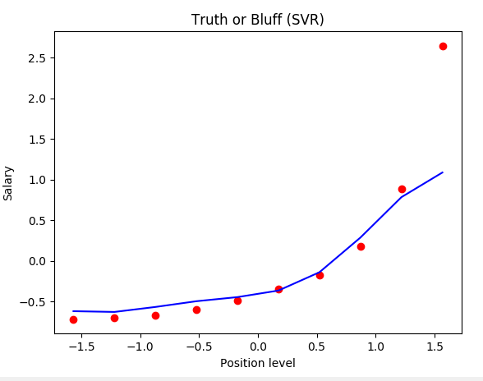
plotting
plt.scatter(X, y, color = 'red')
plt.plot(X, regressor.predict(X), color = 'blue')
plt.title('Truth or Bluff (SVR)')
plt.xlabel('Position level')
plt.ylabel('Salary')
plt.show()

Slide 10
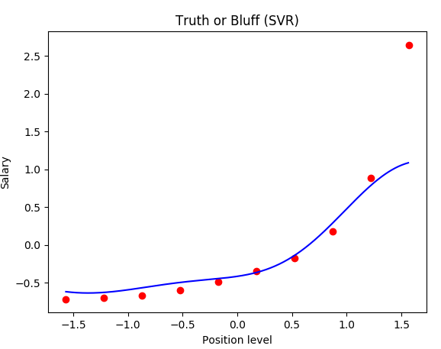
Refined plot
X_grid = np.arange(min(X), max(X), 0.01) # choice of 0.01 instead of 0.1 step because the data is feature scaled
X_grid = X_grid.reshape((len(X_grid), 1))
plt.scatter(X, y, color = 'red')
plt.plot(X_grid, regressor.predict(X_grid), color = 'blue')
plt.title('Truth or Bluff (SVR)')
plt.xlabel('Position level')
plt.ylabel('Salary')
plt.show()

Slide 11
R

Slide 12
Importing the dataset
dataset = read.csv('Position_Salaries.csv')
dataset = dataset[2:3]

Slide 13
Packages
install.packages('e1071')
library(e1071)

Slide 14
Fitting SVR to the dataset
regressor = svm(formula = Salary ~ .,
data = dataset,
type = 'eps-regression',
kernel = 'radial')

Slide 15
Predicting a new result
y_pred = predict(regressor, data.frame(Level = 6.5))

Slide 16
PLOT
# install.packages('ggplot2')
library(ggplot2)
ggplot() +
geom_point(aes(x = dataset$Level, y = dataset$Salary),
colour = 'red') +
geom_line(aes(x = dataset$Level, y = predict(regressor, newdata = dataset)),
colour = 'blue') +
ggtitle('Truth or Bluff (SVR)') +
xlab('Level') +
ylab('Salary')

Slide 17
Smooth Plot
# install.packages('ggplot2')
library(ggplot2)
x_grid = seq(min(dataset$Level), max(dataset$Level), 0.1)
ggplot() +
geom_point(aes(x = dataset$Level, y = dataset$Salary),
colour = 'red') +
geom_line(aes(x = x_grid, y = predict(regressor, newdata = data.frame(Level = x_grid))),
colour = 'blue') +
ggtitle('Truth or Bluff (SVR)') +
xlab('Level') +
ylab('Salary')

